Slide 1
Computer Organization and Architecture Exp 6 Micro-Controller

Slide 2
Preface
Experiment Purpose
(1) Understand the concept of “micro-program”, know the “instruction-microinstruction-microcommand” style of micro-program structure
(2) Master the organization structure and design method of micro-controller.
Experiment content
Design a minimum prototype of CPU: generate the schemed CPU time sequence with sequence generator, and use the autocontrol of micro-controller to achieve the particular CPU function ——Program Jumping.

Slide 3
Instructions
NOP
000 | XX | XX
No operation
HLT
111 | XX | XX
Halt
JMP1
001 | XX | XX
addr1
Direct addressing: addr1->PC
JMP2
010 | XX | XX
addr1
Indirect addressing: addr2=[addr1],addr2->PC

Slide 4
Experiment Program (Store in PROGRAM module)
Assembly statement | Comment | (M address: machine instruction)
JMP1, 06H | Jump to 06H to execute the instruction there | 00H:00100000
 |  | 01H:00000110
HLT | Halt | 02H:11101010
NOP/Addr | No operation/Address | 03H:00001010
NOP | No operation | 04H:00000000
NOP | No operation | 05H:00000000
NOP/Addr | No operation/Address | 06H:00000010
HLT | Halt | 07H:11100001
JMP2, [06H] | Jump to 06H and execute [06H]=02H | 08H:01000000
 |  | 09H:00000110
 | Undefined | 0AH:11111111
 |  | 0BH:11111111

Slide 5
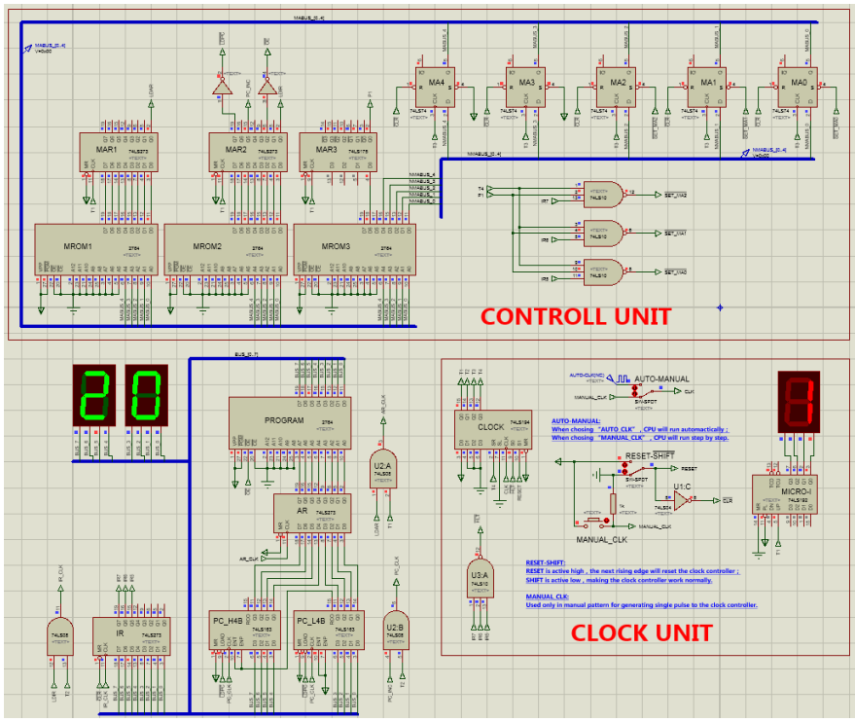

Slide 6
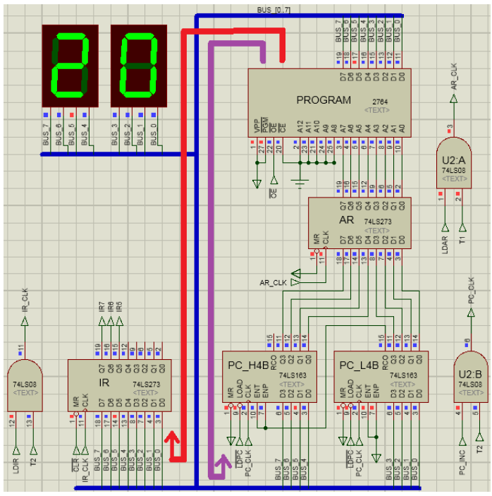
BUS data LED monitor.
The 8-bits can be data or instruction code
Program module to store the program
AR_CLK to load to AR(T1)
Instruction register
Data path
circuit
Address register
PC register
IR_CLK to load BUS’s data to IR (T2)
PC_CLK to make PC increase(T2)

Slide 7
Instruction
NOP
HLT
JMP1
JMP2
Fetch cycle
ROM→IR
ROM→IR
ROM→IR
ROM→IR
HALT
ROM→PC
ROM→PC
Execute cycle
ROM→PC
 |  | Valid micro-operation signal | Function
Instruction flow ROM→IR | T1 | #OE, AR_CLK（LDAR） | PC→AR, ROM→BUS
 | T2 | #OE, IR_CLK (LDIR), PC_CLK (PC_INC) | BUS→IR, PC+1
dataflow ROM→PC | T1 | #OE, #LDPC, AR_CLK (LDAR) | PC→AR, ROM→BUS
 | T2 | #OE, #LDPC, PC_CLK (PC_INC) | BUS→PC

Slide 8
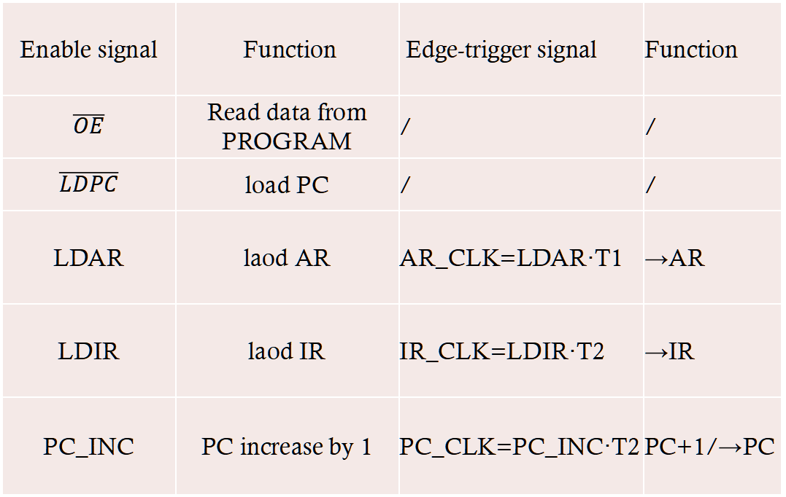
Data path micro-operation signals
Enable signal | Function | Edge-trigger signal | Function
$$\overline{OE}$$ | Read data from PROGRAM | / | /
$$\overline{LDPC}$$ | load PC | / | /
LDAR | laod AR | AR_CLK=LDAR·T1 | →AR
LDIR | laod IR | IR_CLK=LDIR·T2 | →IR
PC_INC | PC increase by 1 | PC_CLK=PC_INC·T2 | PC+1/→PC

Slide 9
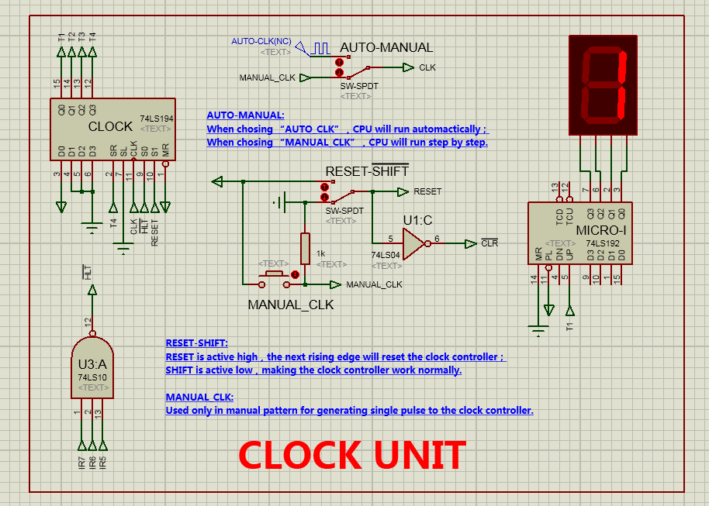
CLOCK to control the Tx cycle
Halt logic

Slide 10
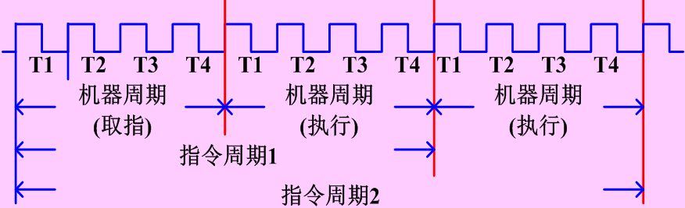
Principle of micro-program
【T1】ROM→BUS
CPU
instruction
State machine of micro-instruction
Instruction cycle
Micro
program
【T2】BUS→target(PC|IR)
Micro-instruction cycle
(machine cycle)
【T3】Fetch micro-address
Micro
instruction
【T4】If P1=1,jump to next micro-address
micro
command
Clock(Tx) cycle
Machine cycle
(Fetch instruction)
Machine cycle
(Execution)
Machine cycle
(Execution)
Instruction cycle 1
Instruction cycle 2

Slide 11
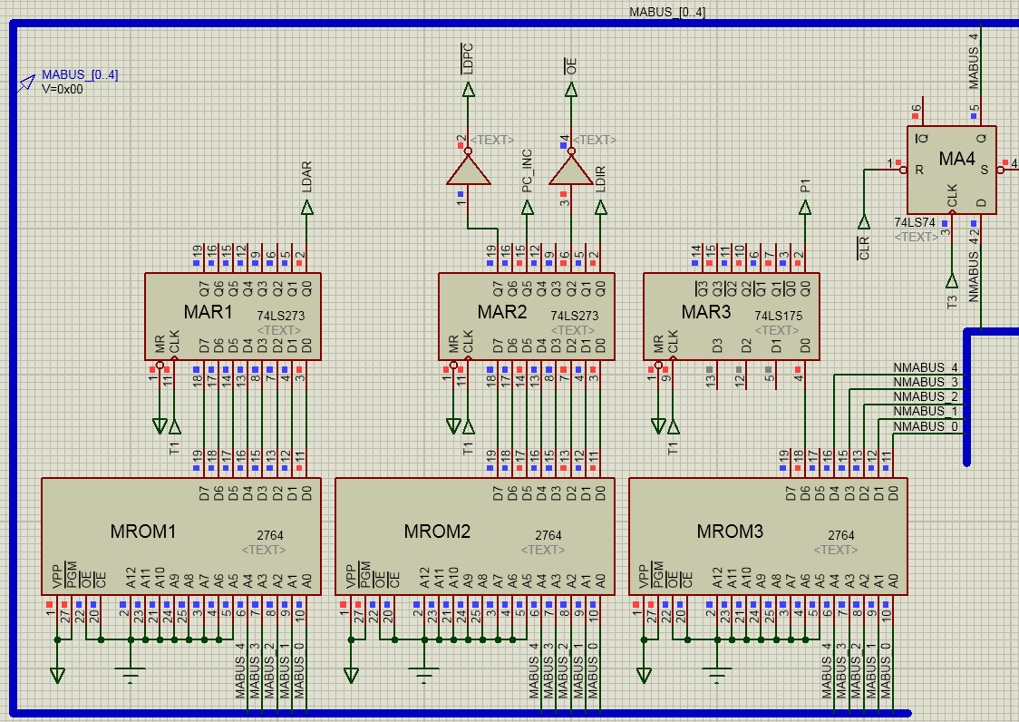
Address jump logical circuit
When in T1 cycle, MARx fetch the micro-instruction code and keep the output in subsequent Tx cycles.
MROMx store the micro-instruction code

Slide 12
LDPC
PC_INC
LDAR
OE
LDIR
P1
uA4 uA3 uA2 uA1 uA0
·
·
·
·
·
·
·
·
·
·
·
·
·
·
·
·
·
·
·
·
·
·
·
24
23
22
21
20
19
18
17
16
15
14
13
12
11
10
9
8
7
6
5
4
3
2
1
Micro-command segment
U-address
Horizontal micro-instruction format
Every bit of micro-command is micro-operation signal, some is defined like LDPC, LDAR, etc. Set “1” to enable, “0” to block.
Micro-instruction code table
Addr | 24 | 23 | 22 | 21 | 20 | 19 | 18 | 17 | 16 | 15 | 14 | 13 | 12 | 11 | 10 | 9 | 8 | 7 | 6 | 5 | 4 | 3 | 2 | 1
00000 | 0 | 0 | 0 | 0 | 0 | 0 | 0 | 1 | 0 | 0 | 1 | 0 | 0 | 1 | 0 | 1 | 0 | 1 | 0 | 0 | 0 | 0 | 0 | 0
00001 | 0 | 0 | 0 | 0 | 0 | 0 | 0 | 1 | 1 | 0 | 1 | 0 | 0 | 1 | 0 | 0 | 0 | 0 | 0 | 0 | 0 | 0 | 0 | 0
00010 | 0 | 0 | 0 | 0 | 0 | 0 | 0 | 1 | 1 | 0 | 1 | 0 | 0 | 1 | 0 | 0 | 0 | 0 | 0 | 0 | 0 | 0 | 0 | 1
00111 | 0 | 0 | 0 | 0 | 0 | 0 | 0 | 0 | 0 | 0 | 0 | 0 | 0 | 0 | 0 | 0 | 0 | 0 | 0 | 0 | 0 | 0 | 0 | 0

Slide 13
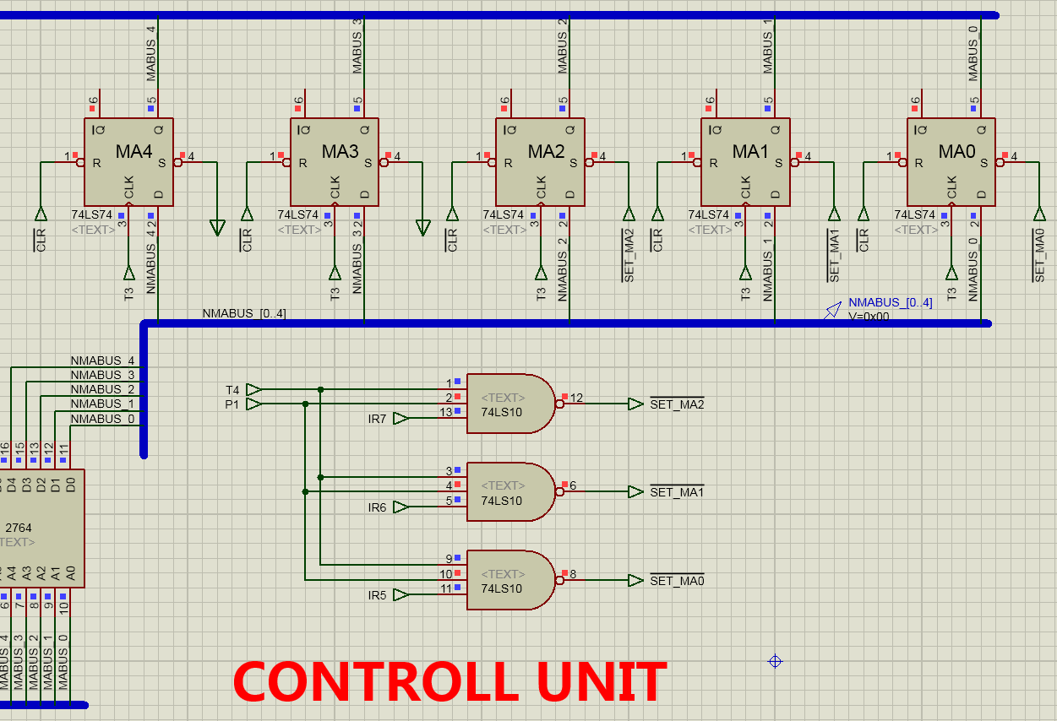
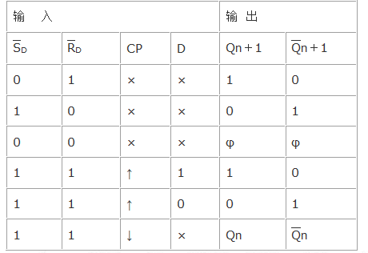
Address jump logical circuit.2
Send next IRx to MROM when in T3.
Input
Output
When P1=1,(which means fetching the instruction from IR)
load the next IR to Max in T4 cycle

Slide 14
Micro-program workflow
Fetch instruction
00000
【T1】PC→AR,ROM→BUS
【T2】BUS→IR, PC+1
00000
Execute
instruction
P1( 0 0 I₇ I₆ I₅ )
start
00111
HALT
00000
NOP/HLT(I₇I₆I₅ =000/111)
【T1】PC→AR,ROM→BUS
【T2】BUS→IR, PC+1
00000
00000
P1 ( 0 0 I₇ I₆ I₅ )
【T1】PC→AR,ROM→BUS
【T2】BUS→IR, PC+1
00010
00000
【T1】PC→AR,ROM→BUS
【T2】BUS→PC
P1 ( 0 0 I₇ I₆ I₅ )
00001
00001
00001
【T1】PC→AR,ROM→BUS
【T2】BUS→PC
【T1】PC→AR,ROM→BUS
【T2】BUS→PC
00000
00000
end
JMP2(I₇I₆I₅ =010)
JMP1(I₇I₆I₅ =001)

Slide 15
Micro-program structure
IR
OP code
State condition
…
Address jump
Logical circuit
Address decode
Address register
Micro-Operation signal
Control ROM
(MROMx)
……
Micro-instruction register
Micro-command segment
P1, P2

Slide 16
Experiment Steps
Exp1: JMP1 and JMP2
According to the code below, compile and make the hex files and burn them into EPROM1、EPROM2、EPROM3 seperatively(WARNING: DO NOT MESS IT).
EPROM1 | EPROM2 | EPROM3
ORG 0000H DB 00000001B DB 00000001B DB 00000001B DB 00000000B DB 00000000B DB 00000000B DB 00000000B DB 00000000B END | ORG 0000H DB 00100101B DB 10100100B DB 10100100B DB 00000000B DB 00000000B DB 00000000B DB 00000000B DB 00000000B END | ORG 0000H DB 01000000B DB 00000000B DB 00000001B DB 00000000B DB 00000000B DB 00000000B DB 00000000B DB 00000000B END
Question: In the micro-instruction table, [00001] and [00010]’s operation
is completely same.So, can we merge these two instructions? If not,why?

Slide 17
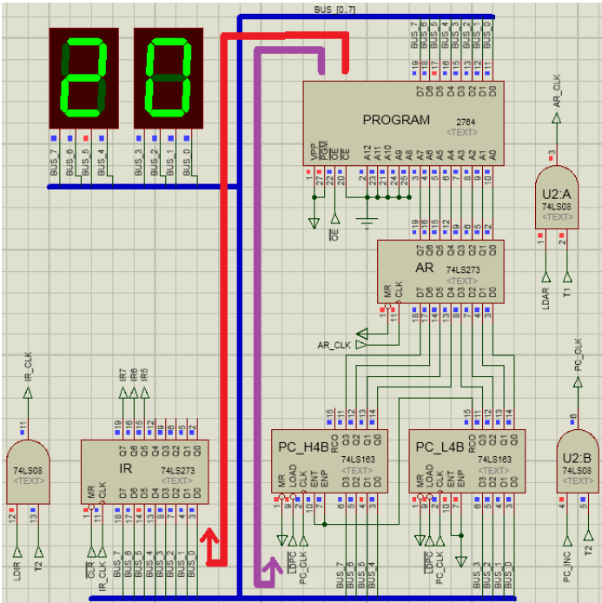
Compile the code below and burn it into PROGRAM module.
ORG 0000H
DB 00100000B; JMP1, 06H
DB 00000110B
DB 11101010B; HLT
DB 00001010B; NOP/Addr
DB 00000000B
DB 00000000B
DB 00000010B; NOP/Addr
DB 11100001B; HLT
DB 01000000B; JMP2, [06H]
DB 00000110B
END

Slide 18
Before start, swtich CLK to MANUAL_CLK; Start simulation, make RESET=1, manually press MANUAL_CLK to make CLK rising-edge transit. Initial {T1,T2,T3,T4}={1,0,0,0}; MAKE RESET=0 and the initial process complete.
Press MANUAL_CLK and make CLK pulse as“ ”, step over the above program. In the instruction cycle of JMP1 and JMP2, compare to workflow of _ ,observe the function of micro-instruction and the stepping result( data of AR,IR,PC,BUS).
Switch CLK to AUTO_CLK(10hz)，the program will run to HLT break point and pause. Look into the number of micro-instruction cycles in break point and the result data of AR,IR,PC,BUS. Then enable RESET as “0->1->0”, jump out break point and run the next instruction

Slide 19
Exp2: JMP3
Add a new jump instruction JMP3 as below. Supply the micro-program workflow and micro-instruction code table. Implement the function of JMP3.
instruction | OP code | ML program | comment
JMP3 | 011 | 01100000; JMP3 xxxxxxxx; addr1 | Secondary indirect addressing: program jump 3 times to addr3 to excute [addr1] =addr2, [addr2]= addr3, addr3→PC;

Slide 20
Compile the code to hex file and burn it to PROGRAM.
ORG 0000H
DB 00100000B; JMP1, 06H
DB 00000110B
DB 11101010B; HLT
DB 00001010B; NOP/Addr
DB 01100000B; JMP3, [[0BH]]
DB 00001011B
DB 00000010B; NOP/Addr
DB 11100001B ; HLT
DB 01000000B; JMP2, [06H]
DB 00000110B
DB 11100000B; HLT
DB 00000011B; NOP/Addr
END

Slide 21
Refer to the initial process and step over method of exp1, repeat the experiment and observe the result data.
Refer to the method of auto-run and jumping out of break point in exp1, auto run the program, observe the micro-instruction cycles in break point and the data of AR,IR,PC,BUS.
Question: In this experiment’s program, some addresses is annotated as “NOP/[ADDR]”. What’s the difference of NOP and NOP/[ADDR]?
Under what situation it will do nothing or jump the program?

